Slide 1
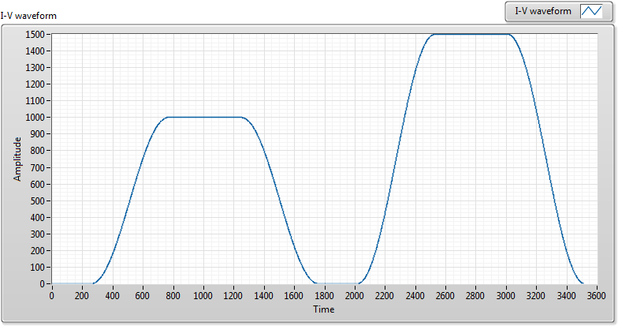
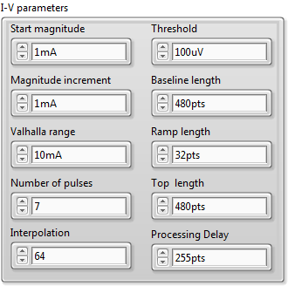
<V_{base}>
<V_{top}>
<Vtop>-<Vbase>
Magnitude increment
Ramp length
Top length
Processing delay
Start magnitude
Baseline length

